Slide 1

Beef
The Browser Exploitation Framework

Slide 2
Overview
BeEF is a Browser Exploitation Framework that focuses on exploiting vulnerabilities in the web browser.
It is a tool for testers to check how safe a system is by controlling web browsers and launching attacks from within the browser.
Purpose
to enable testers to gain control of a target system, assess its security, execute various attacks, and send commands to the victim's web browser for testing and evaluation.

Slide 3
Common Features
Show alert box
Show fake browser update
Google phishing
Get victim’s geo location
Get victim’s ip address
stealing user input
Show fake notifications bar
Facebook phishing
Show fake application update
launching a Firefox based DOS attack
redirecting the web page to the fake page
logging the keystrokes
Tabnabbing

Slide 4
Technical design
BeEF hook is a Javascript file, used to latch on to a target’s browser to exploit while acting as C&C between it and the attacker.
To target a web browser, first identify a webpage and then attach a BeEF hook to it
Deliver javascript payload by including the javascript hook into the web page’s header. The target browser will become hooked once they visit the site.
Attacker can see all sorts of information such as plugins and extensions that the browser is using and various information about the hardware and software spaces of the target.

Slide 5
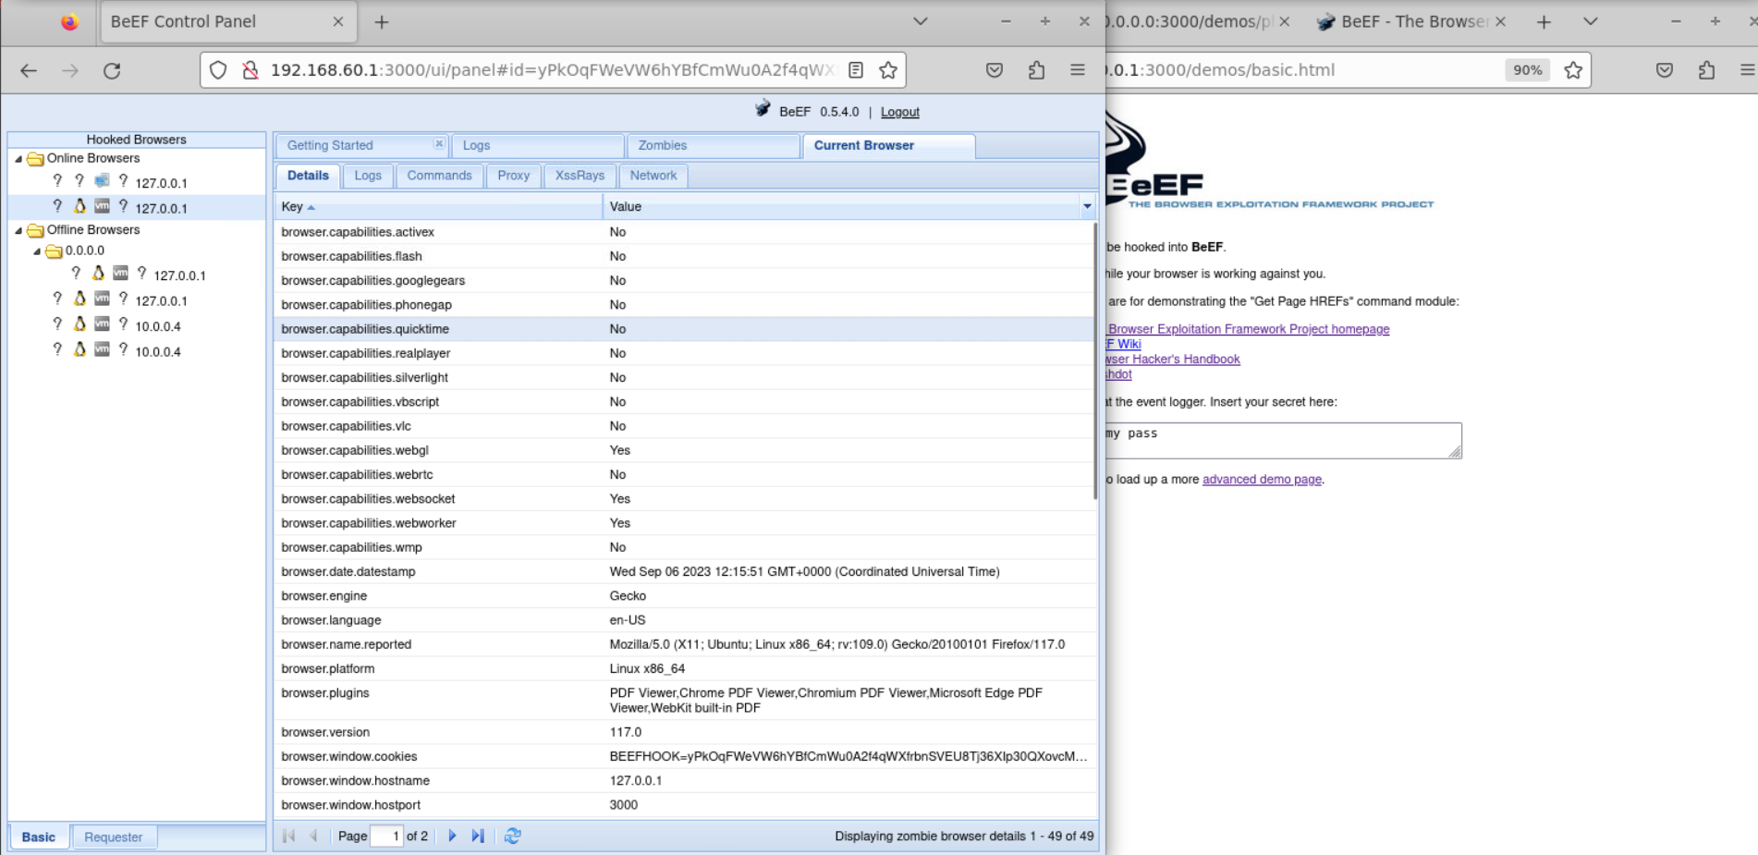
Browser Information

Slide 6
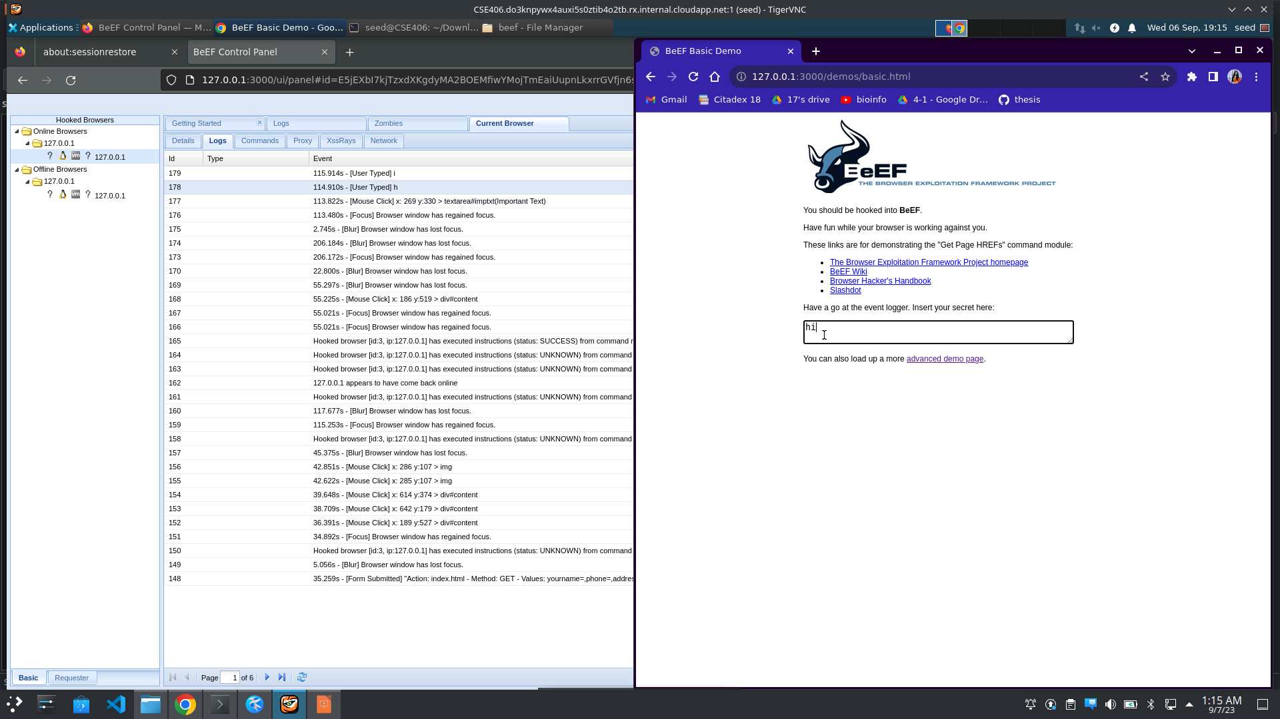
Browser Information
creates complete logs of mouse movements, double clicks and other actions perform by victims

Slide 7
Demonstration of some key features

Slide 8
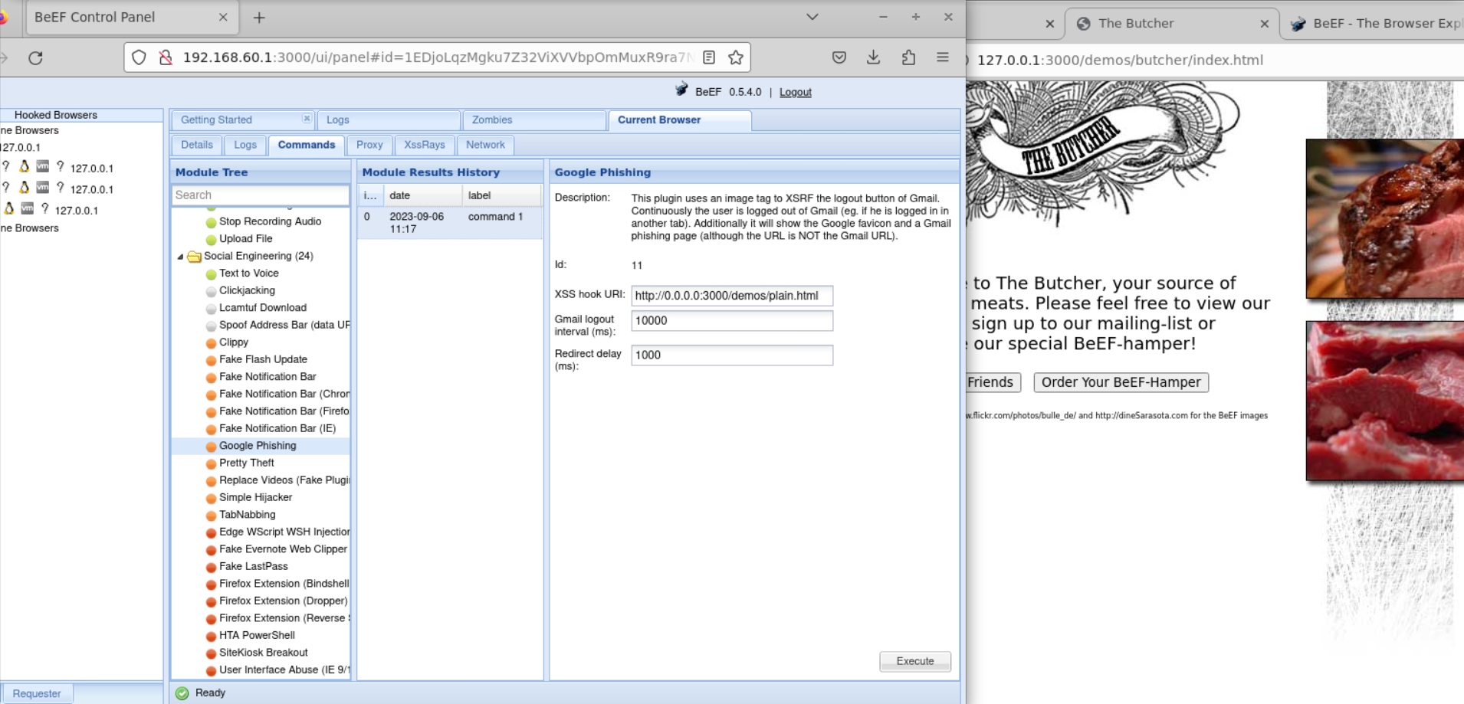
Google Phishing Example
Current page
Giving the hook url where the page will be redirected after attack taking place
redirected page url

Slide 9
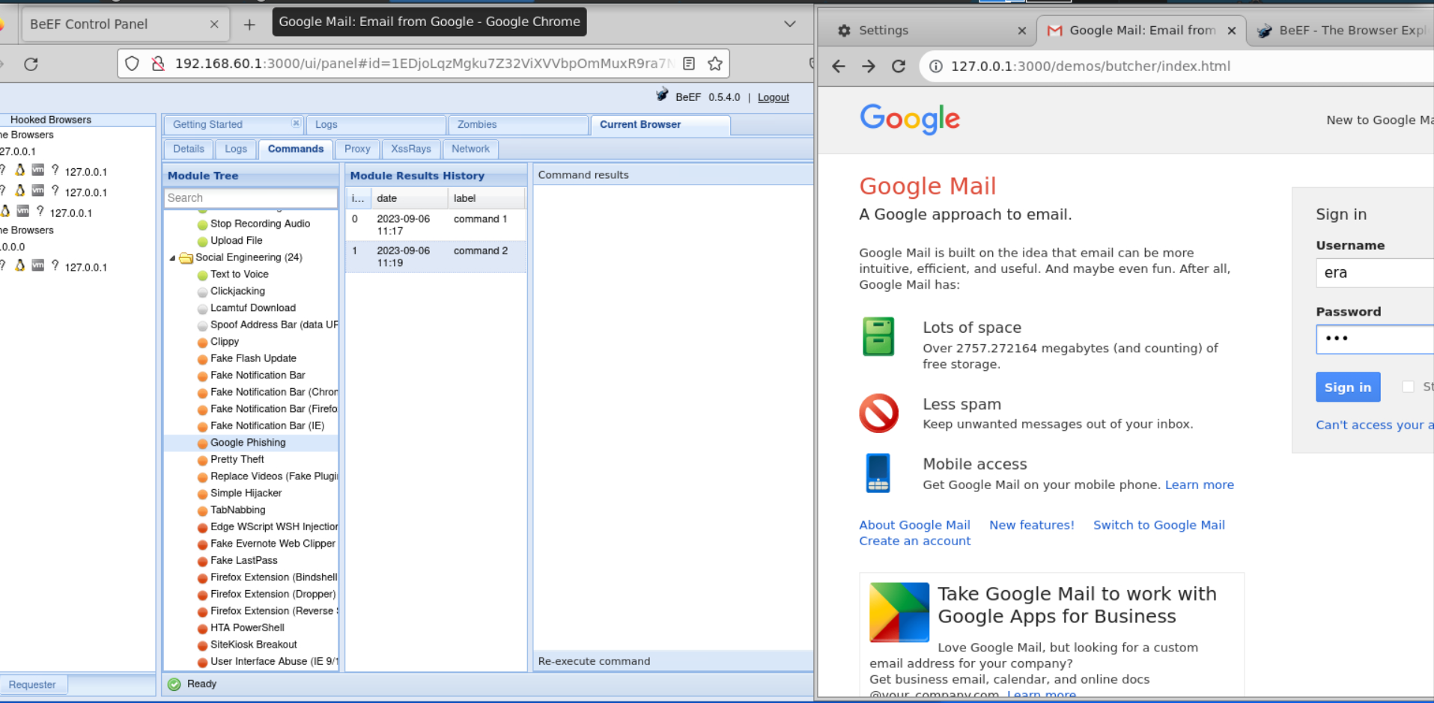
Google Phishing Example
Showing the fake “Sign In” page

Slide 10
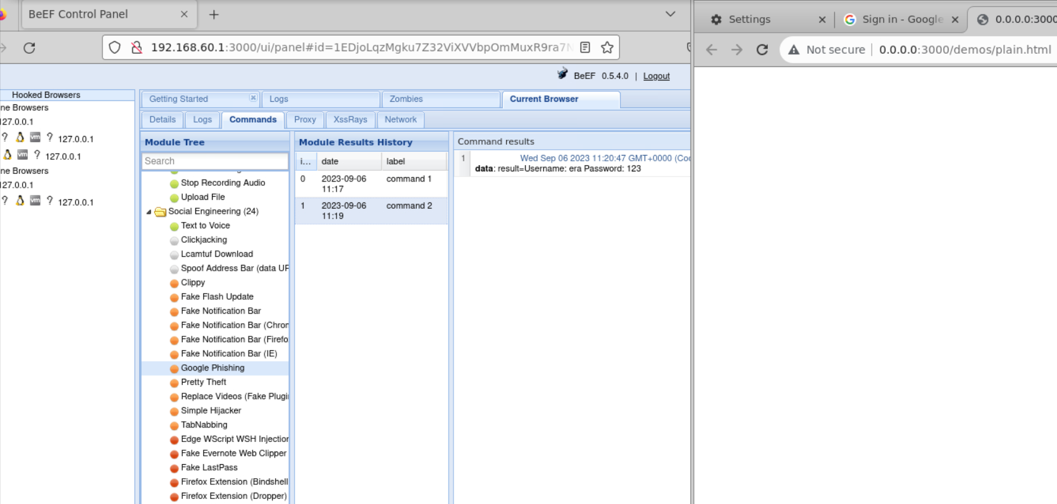
Google Phishing Example
Collecting user information and redirecting to another fishing url

Slide 11
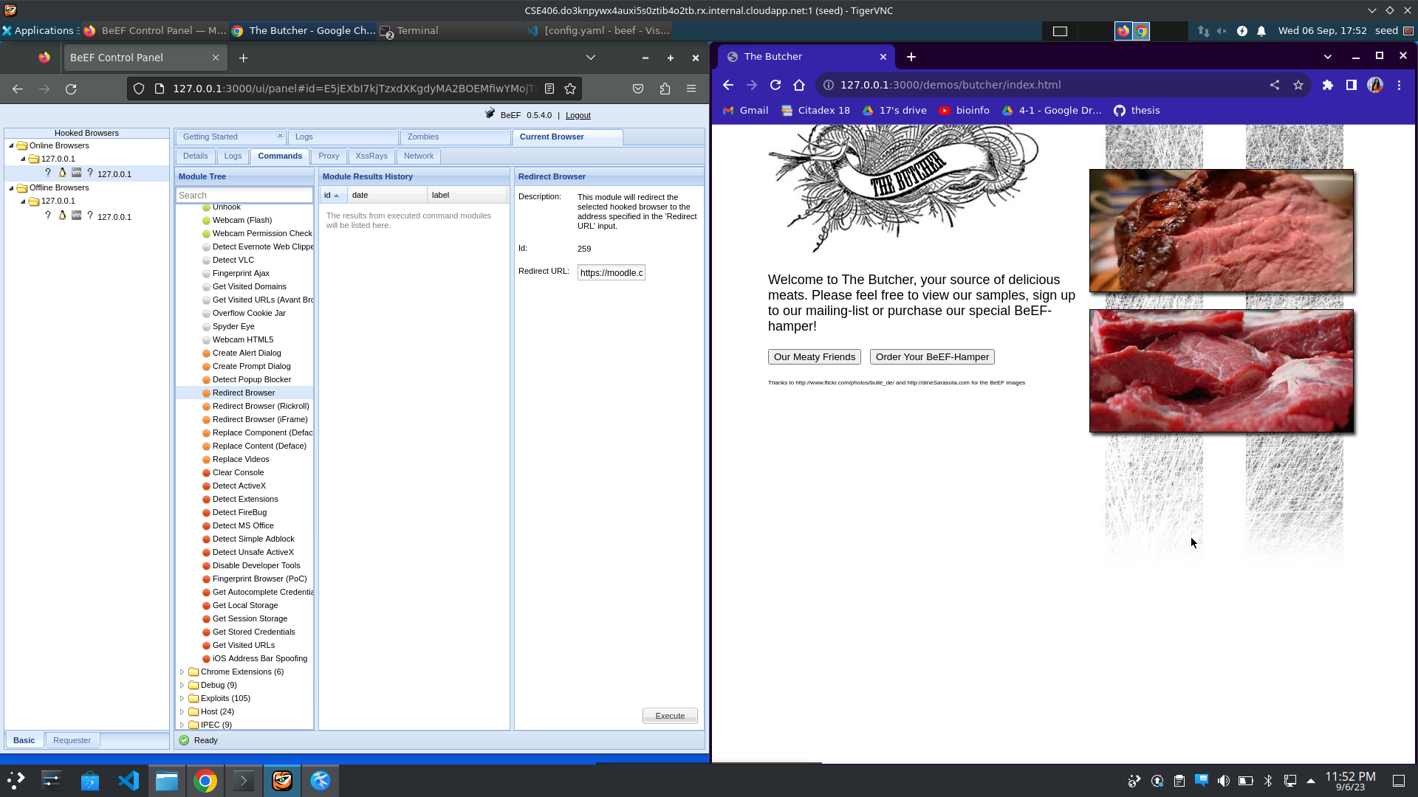
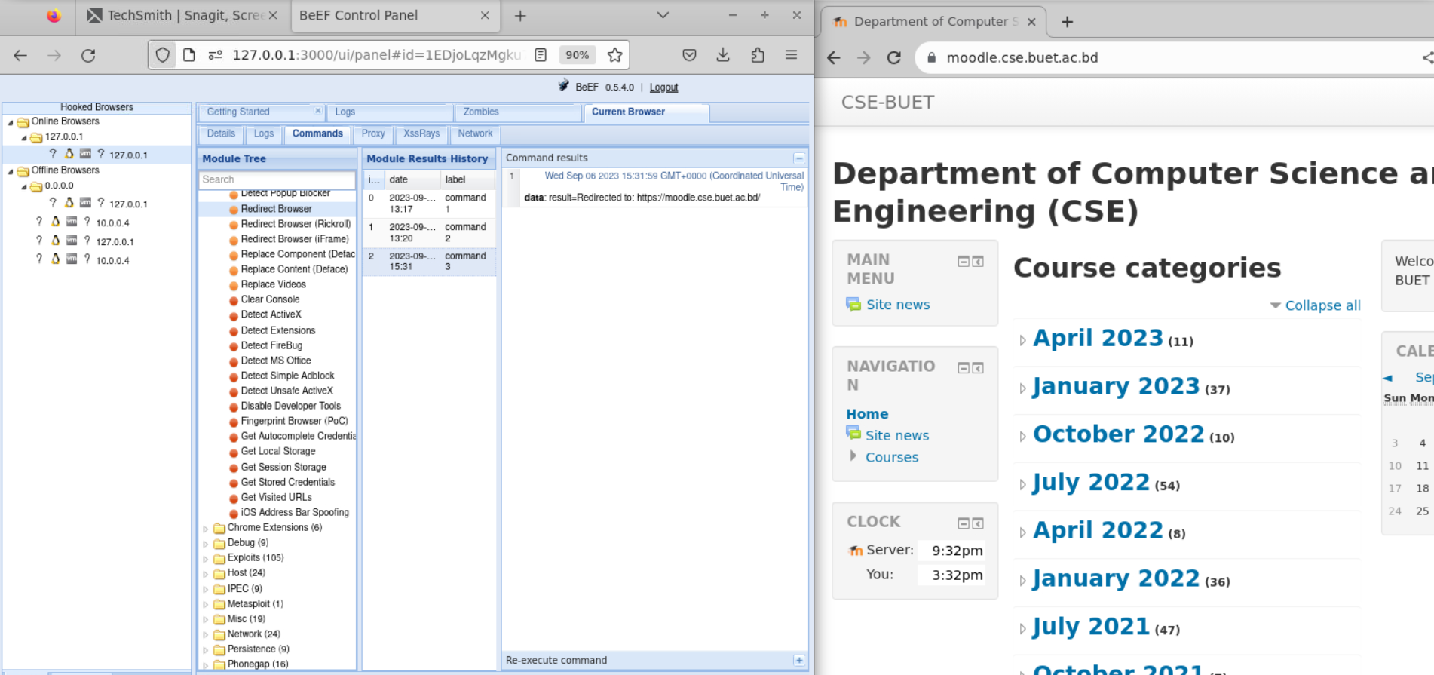
Redirect Browser Example
Giving the hook url where the page will be redirected after attack taking place

Slide 12
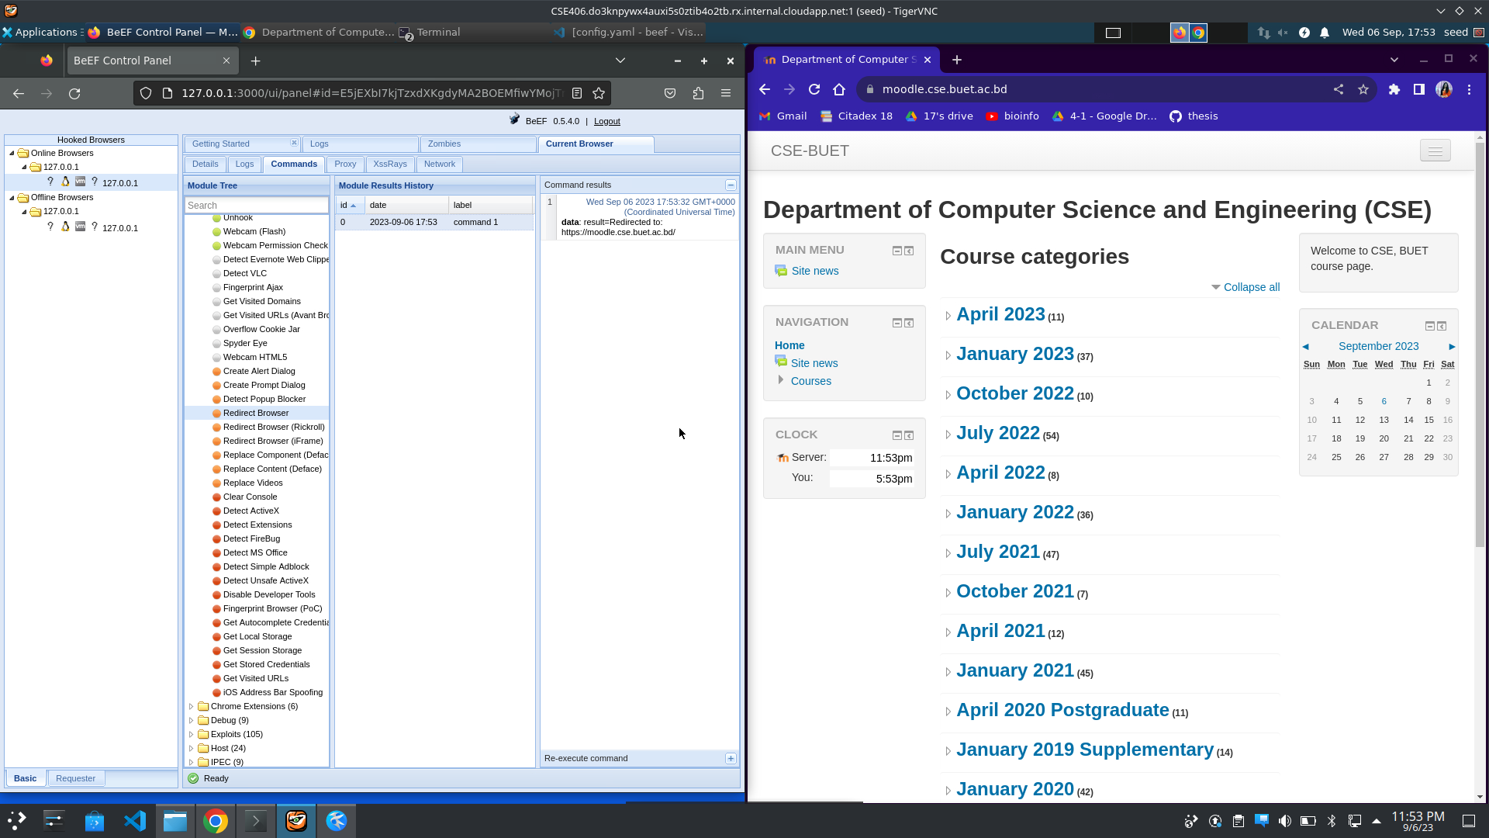
Redirect Browser Example
Redirecting to the phishing site

Slide 13
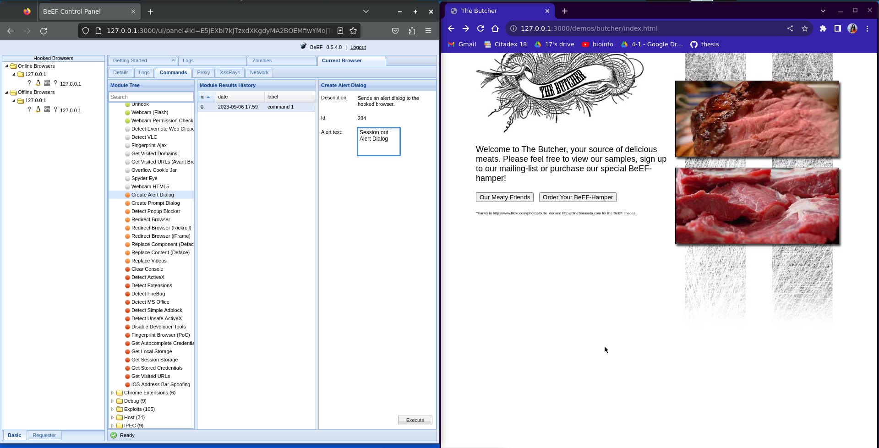
Alert Dialog Example
Sending fake alert message to user

Slide 14
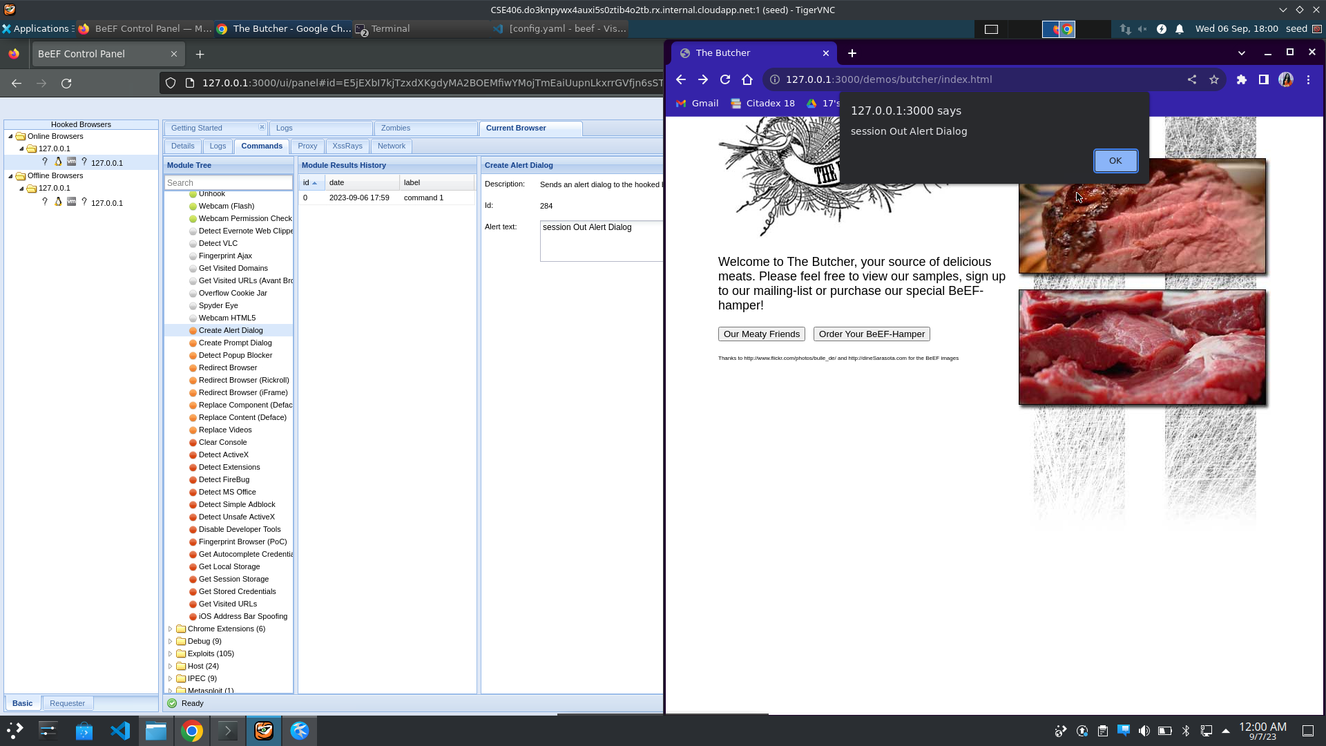
Alert Dialog Example
Sending fake alert message to user

Slide 15
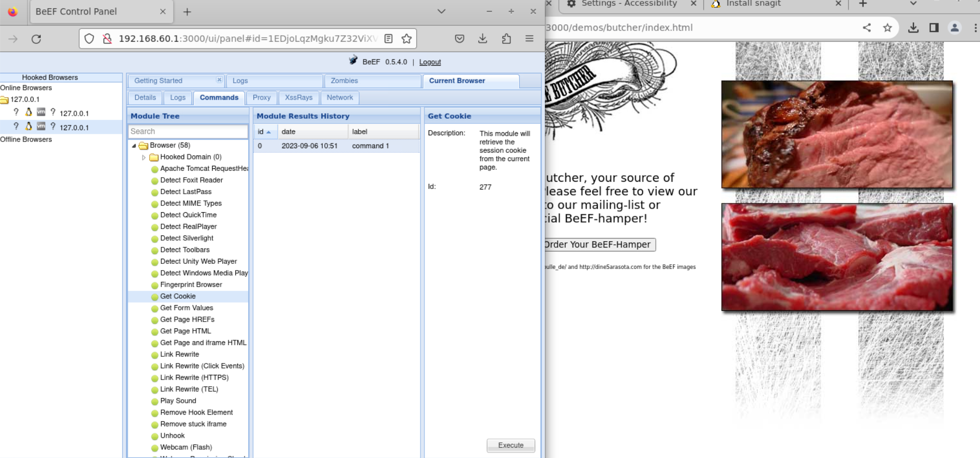
Get Cookie Example
Retrieving current session cookies

Slide 16
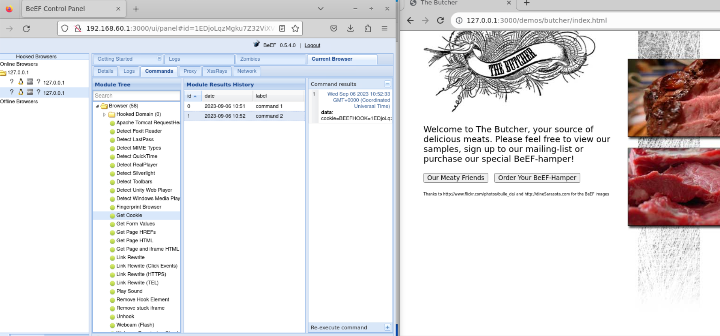
Get Cookie Example

Slide 17
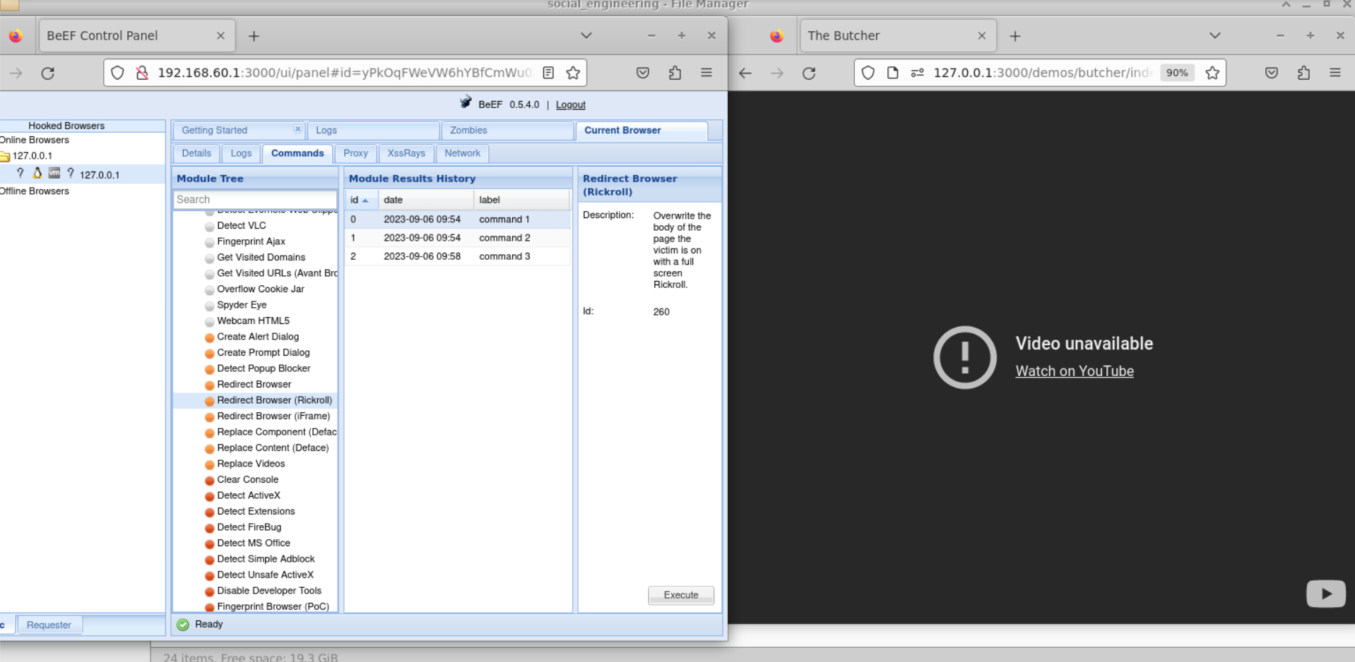
Redirect Browser(Rickroll) Example
Overwriting the body of the page with a full screen rickroll

Slide 18
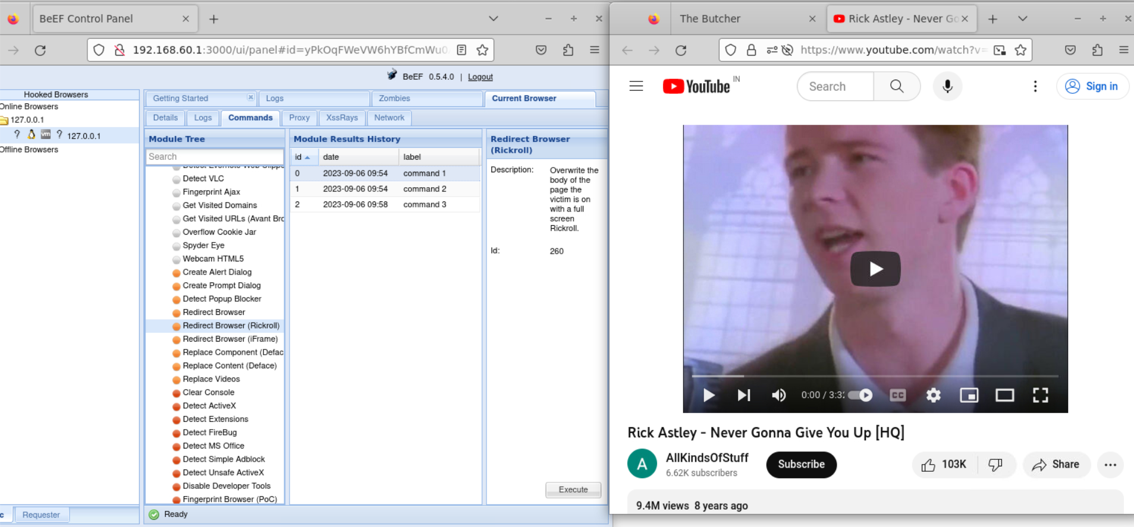
Redirect Browser(Rickroll) Example

Slide 19
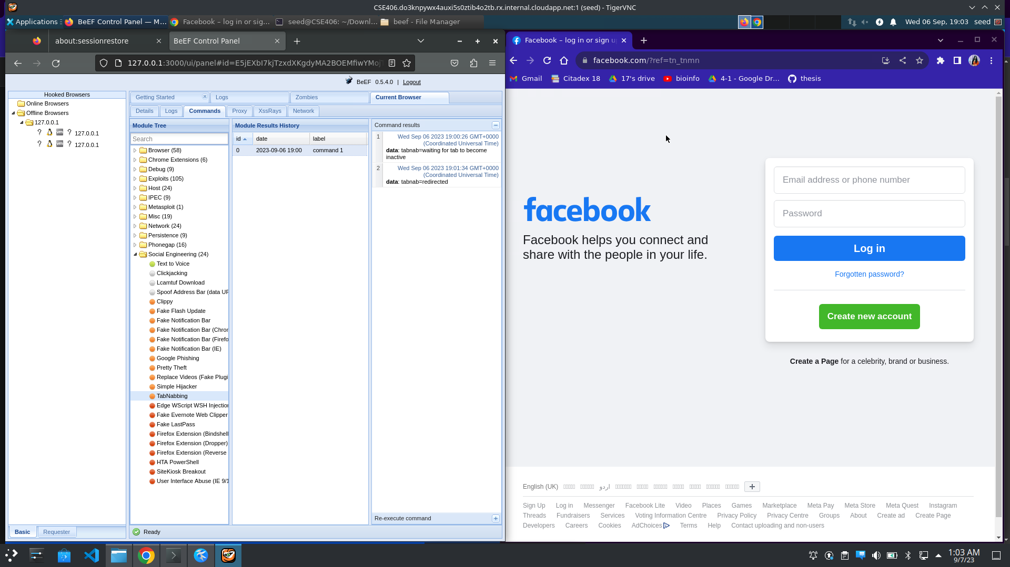
Tabnabbing Example
Redirects to the specified URL after the tab has been inactive for a specified amount of time

Slide 20
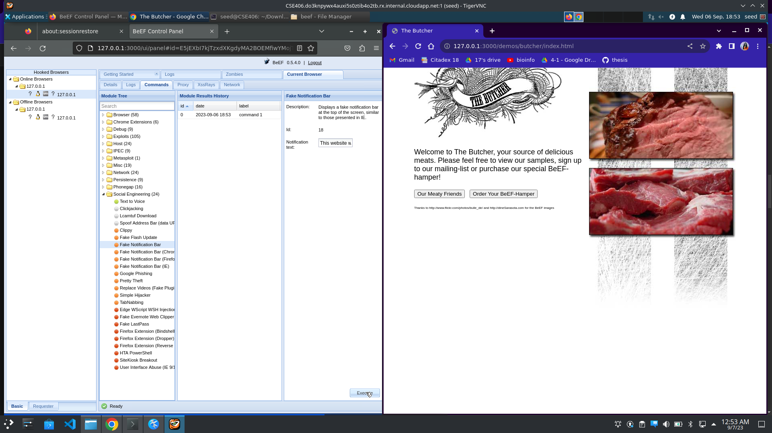
Fake Notification Bar Example
Displays fake notification bar at the top of screen

Slide 21

Fake Notification Bar Example

Slide 22
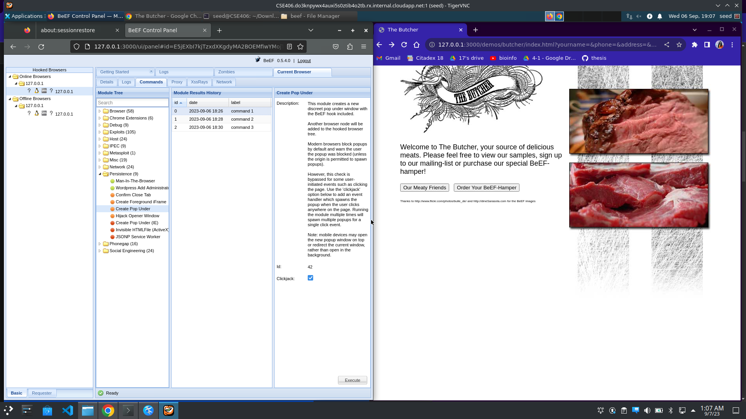
Create Pop Under Example
Creates a new discreet pop under window with BeEF hook included and thus another browser node will be added to the hooked browser tree

Slide 23
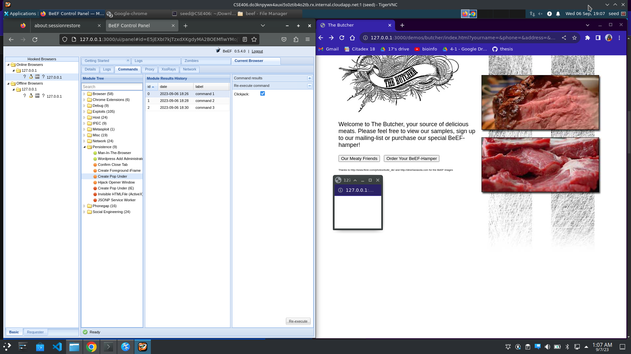
Create Pop Under Example

Slide 24
Thank you
Presented by: 1805104- Swarnali Saha
1805116- Sanjida Islam Era

